Slide 1
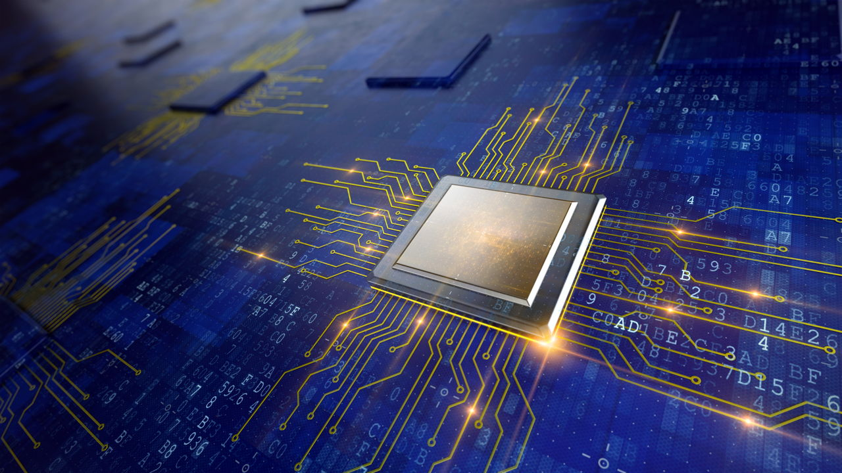
Designing Virtual Memory Manager
GROUP - 2
Roll No Name of students
AM.EN.U4AIE20002 Abhinandhu A
AM.EN.U4AIE20035 Hariprasad S
AM.EN.U4AIE20045 M Mahadev
AM.EN.U4AIE20046 Maddala H S M Krishna Karthik
AM.EN.U4AIE20048 Marasani Jayasurya

Slide 2
Introduction
Virtual memory manager maintains a copy of memory of all programs, coordinates the process of address translation.
The virtual memory manager is simulating the process of logical to physical address translation.
The reason for the high need of virtual memory management is :
Scarcity of Main Memory.
For execution, a program must reside in ‘Main Memory.

Slide 3
Terminology
Logical address
Physical address
Page
Frame Number
Page table
TLB
Fifo

Slide 4
Problem
A program is needed to be done which is concerned with reading logical address and translating them to their corresponding physical addresses.
The program needs to read a file containing several 32-bit integer numbers that represent logical addresses.
The specifics include:
256 entries on the page table
Page size of 256 bytes
16 entries in the TLB
Frame size of 256 bytes
256 frames
Physical memory of 65,536 bytes (16 bit)

Slide 5
Methodology
Language | C++ language
Data | Integer
Page Table | Array
Physical Memory | Integer
Input | Txt File (address.txt)
Output | Txt File (output.txt)
Page Replacement Algorithm | FIFO
Code | Github Link

Slide 6
Steps Involved
Extract ‘Page Number’ and ‘Offset’ (Logical address)
Find the corresponding frame number using page number.
Consult TLB. If there is TLB hit, the frame number is obtained from TLB.
If there is a TLB miss, consult page table. If there is a page table hit, the frame number is obtained.
Otherwise, page fault occurs. After handling page fault, restart the process, frame number can be retrieved from TLB.
Concatenate: ‘Frame Number’ and ‘Offset’ to get the corresponding ‘Physical address’.
With frame number and offset, data can be extracted from physical memory.

Slide 7
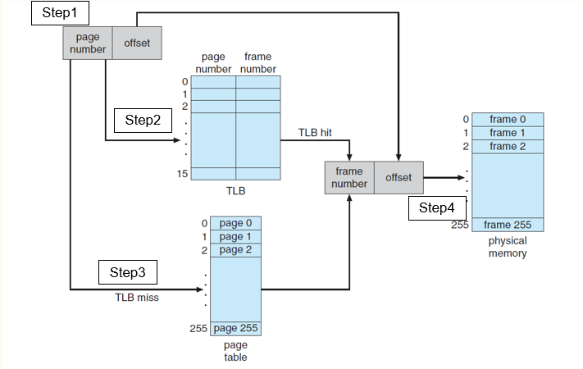
Block Diagram

Slide 8
Page replacement algorithm
In a computer operating system that uses paging for virtual memory management, page replacement algorithm decide which memory pages to page out when a page memory need to be allocated.
Its types are:
FIFO (First in First Out)
LRU (Least Recently used)
OPT (Optimal)

Slide 9
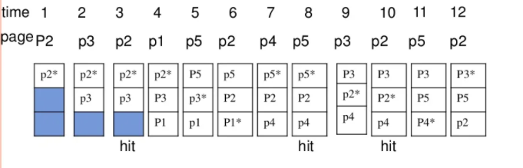
Contd.
FIFO (first in first out):
It is used to select the page for replacement that has been in memory the longest time.

Slide 10
Result and Analysis
The program reads the file addresses.txt, which includes 1000 logical addresses ranging from 0 to 65535, and converts them to physical addresses.
Program displays and stores the following values to output.txt
The logical addresses being translated
The corresponding physical addresses
Number of translated addresses
TLB hit rate - The percentage of address references that were resolved in the TLB. Also, TLB miss rate - opposite to TLB hit rate.
Page-table hit rate - The percentage of address references that were resolved in the page table. Also, Page-table miss rate - opposite to Page-table hit rate
Page-fault rate - The percentage of address references that resulted in page faults.

Slide 11
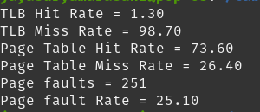
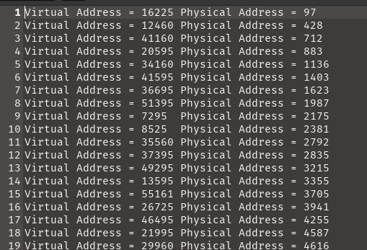
Sample Result
Number of Translated Addresses = 1000
TLB Hit Rate = 1.30%
TLB Miss Rate = 98.70%
Page Table Hit Rate = 73.60%
Page Table Miss Rate = 26.40%
Page Fault Rate = 25.10%

Slide 12
Reference
YA, Divya. (2019). An Efficient Virtual Memory using Graceful Code. International Journal of Trend in Scientific Research and Development. Volume-3. 623-626.10.31142/ijtsrd23878.
Rafal Kolanski, “A logic for virtual memory “, Electronic Notes in theoretical computer science 217, Pages 61- 77, 2008
Bensoussan, R.C.Daley, ”The multics virtual memory: concept and design“, volume 15, no.5, PP 3078,318,1 May 1972.
X. Zhou, P Petrov, “Towards virtual memory supports in realtime and memory constraint embedded applications the interval page system”, Received on 11th march 2009, Revised on 19 th march 2009.
Archana s. sumant, Pramila M. Chawan, “Virtual memory techniques in 2.6 kernel and challenges“, vol 2, no., ISSN : 1793-823; 2, april 2010.

Slide 13
Thank you

